Slide 1
PageRank on GCP
Submitted by Manish Bafna
Student Id: 19655

Slide 2
Table of Content
Introduction
Design
Implementation on GCP using Pyspark
Implementation on GCP using SCALA
Test
Conclusion
Enhancement Ideas
References

Slide 3
Introduction
Implement PageRank on the Google Cloud Platform
The PageRank algorithm, named after Google’s Larry Page, aims to assign a measure of importance (a “rank”) to each document in a set based on how many documents have links to it.
As an example of a more involved algorithm that can benefit from RDD partitioning, we consider PageRank.
It can be used to rank web pages, of course, but also scientific articles, or influential users in a social network (by treating each user as a “document” and each friend relationship as a “link”).

Slide 4
Design Approach
PageRank is an iterative algorithm that performs many joins, so it is a good use case for RDD partitioning. The algorithm maintains two datasets: one of (pageID, linkList) elements containing the list of neighbors of each page, and one of (pageID, rank) elements containing the current rank for each page. It proceeds as follows:
Initialize each page’s rank to 1.0
On each iteration, have page p send a contribution of rank(p) / numNeighbors(p) to its neighbors (the pages it has links to).
Set each page’s rank to 0.15 + 0.85 * contributionsReceived.

Slide 5
Design Approach
The last two steps repeat for several iterations, during which the algorithm will converge to the correct PageRank value for each page. As a simple solution, it’s typically enough to run about ten iterations and declare the resulting ranks to be the PageRank values.

Slide 6
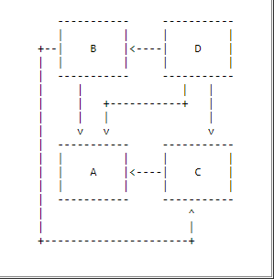
Design

Slide 7
Design
An iterative algorithm that performs many joins, so it is a good use case for RDD partitioning.
The algorithm maintains two datasets:
(pageID, linkList) elements containing the list of neighbors of each page,
(pageID, rank) elements containing the current rank for each page.

Slide 8
Design
Initialize each page’s rank to 1.0
On each iteration, have page p send a contribution of rank(p) / numNeighbors(p) to its neighbors (the pages it has links to).
Set each page’s rank to 0.15 + 0.85 * contributionsReceived. Note:
0.85 is the damping factor

Slide 9
Page Rank - Example

Slide 10
Page Rank - Example
If
The initial PageRank value for each webpage is 1.
PR(A) = 1
PR(B) = 1
PR(C) = 1
Page B has a link to pages C and A
Page C has a link to page A
Page D has links to all three pages

Slide 11
Page Rank - Example
and
A's PageRank is PR(A) = (1-d) + d * (PR(B) / 2 + PR(C) / 1 + PR(D) / 3)
B's PageRank is PR(B) = (1-d) + d * (PR(D) / 3)
C's PageRank is PR(C) = (1-d) + d * (PR(B) / 2 + PR(D) / 3)
D's PageRank is PR(D) = 1-d
Damping factor is 0.85

Slide 12
Page Rank - Example
Then after 1st iteration
Output
Page B would transfer half of its existing value, or 0.5, to page A and the other half, or 0.5, to page C.
Page C would transfer all of its existing value, 1, to the only page it links to, A.
Since D had three outbound links, it would transfer one third of its existing value, or approximately 0.33, to A.

Slide 13
Page Rank - Example
Input
PR(A) = (1-d) + d * (PR(B) / 2 + PR(C) / 1 + PR(D) / 3) = (1-0.85) + 0.85 * (0.5 + 1 + 0.33) = 1.71
PR(B) = (1-d) + d * (PR(D) / 3) = (1-0.85) + 0.85 * 0.33 = 0.43

Slide 14
Page Rank - Example
PR(C) = (1-d) + d * (PR(B) / 2 + PR(D) / 3) = (1-0.85) + 0.85 * (0.5 + 0.33) = 0.86
PR(D) = 1-d = 0.15

Slide 15
Observations
A web page does not have input will have
constant PageRank: 1-d
the smallest PageRank
Input Web Pages' impact to the PageRank of a web page
The more Input Web Pages the better.
The higher PageRank of an Input Web Page the better.

Slide 16
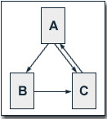
Problem Statement
Calculate the PageRank with the following assumptions:
the initial PageRank value for each webpage is 1.
the damping factor is 0.85
the relation of the webpages is

Slide 17
Implementation Approach
Manually calculate PageRank for each node for the first 2 iterations.
Create a file in HDFS to show the references among the nodes.
Execute the program on GCP using SCALA and Pyspark
Compare the output of program and the result of Step a.

Slide 18
Manual Calculations
First iteration A = 1 B = (1/2) = 0.5 C = 1 + (1/2) = 1.5 PageRank (A) = 1 – 0.85 + 0.85 * 1 = 1 PageRank (B) = 1 – 0.85 + 0.85 * 1 = 0.575 PageRank (C) = 1 – 0.85 + 0.85 * 1.5 = 1.425
Second iteration A = 1 B = (1/2) = 0.5 C = 0.575 + (1/2) = 1.075 PageRank (A) = 1 – 0.85 + 0.85 * 1.425 = 1.36125 PageRank (B) = 1 – 0.85 + 0.85 * 0.5 = 0.575 PageRank (C) = 1 – 0.85 + 0.85 * 1.075 = 1.06375

Slide 19
Data
A B
A C
B C
C A

Slide 20

Implementation on GCP
Login to GCP and link a billing account for the project that was already created during last login

Slide 21
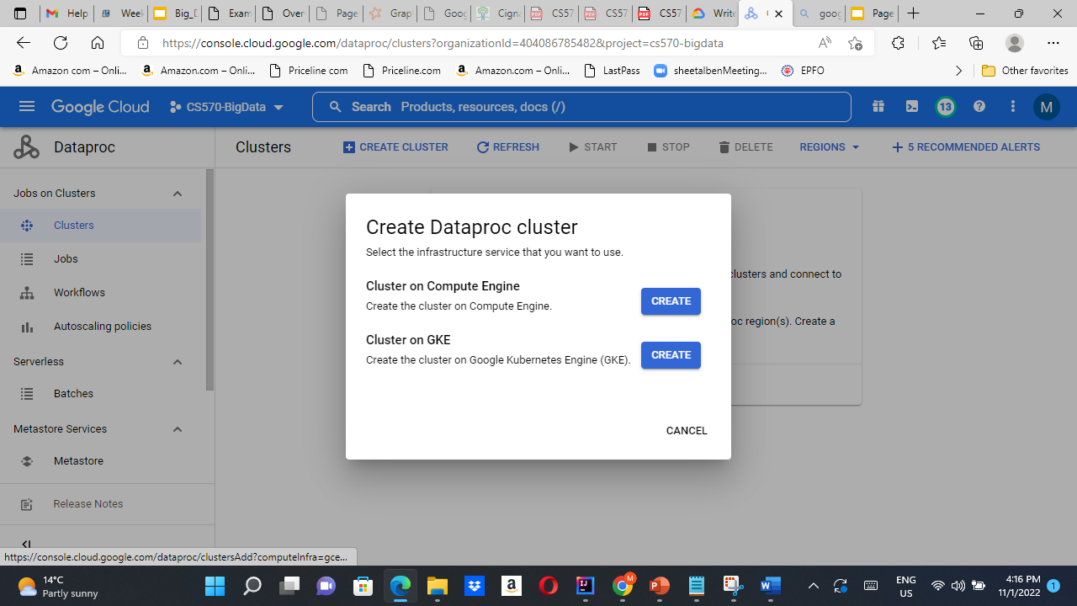
Implementation on GCP
Create the dataproc cluster and launch SSH

Slide 22
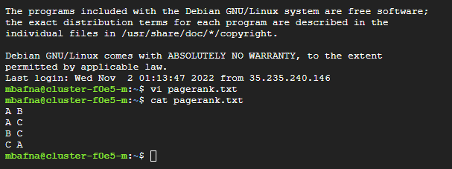
Implementation on GCP using Pyspark
Create new file:
vi pagerank.txt

Slide 23

Implementation on GCP using Pyspark
set up directory and copy file into directory
hdfs dfs -mkdir hdfs:///mydata
hdfs dfs -put pagerank.txt hdfs:///mydata
hdfs dfs -ls hdfs:///mydata

Slide 24
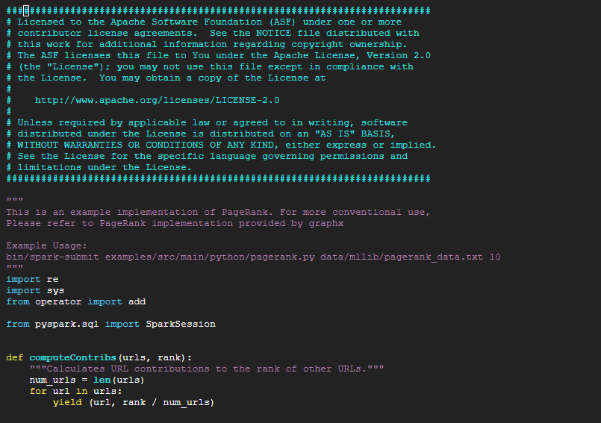
Implementation on GCP using Pyspark
Run PageRank code using Python
Prepare the code
vi pagerank.py

Slide 25
Test
run the program
spark-submit pagerank.py hdfs:///mydata/pagerank_data.txt 1 (first iteration)
same as manual calculation

Slide 26
Test
run the program
Tenth iteration
same as manual calculation

Slide 27
Implementation on GCP using SCALA
Create input file:
vi pagerank.txt

Slide 28
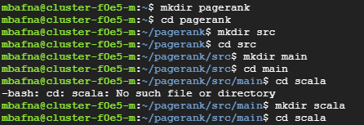
Implementation on GCP using SCALA
Create SCALA code file:
Create the path to mbafna@cluster-f0e5-m:~/pagerank/src/main/scala$

Slide 29
Implementation on GCP using SCALA
Create SCALA code file:
Create file SparkPageRank.scala

Slide 30
Implementation on GCP using SCALA
Create SCALA code file:
Create file SparkPageRank.scala (Refer SparkPageRank.scala file

Slide 31
Implementation on GCP using SCALA
Install SBT:
back to the up 3 level parent directory

Slide 32
Implementation on GCP using SCALA
Install SBT:
Run following commands:
echo "deb https://repo.scala-sbt.org/scalasbt/debian all main" | sudo tee /etc/apt/sources.list.d/sbt.list
echo "deb https://repo.scala-sbt.org/scalasbt/debian /" | sudo tee /etc/apt/sources.list.d/sbt_old.list
curl -sL "https://keyserver.ubuntu.com/pks/lookup?op=get&search=0x2EE0EA64E40A89B84B2DF73499E82A75642AC823" | sudo apt-key add
sudo apt-get update
sudo apt-get install sbt

Slide 33
Implementation on GCP using SCALA
Create build.sbt file
Run following commands:
Vi build.sbt
Enter the following and save the file
name := "Simple Project"
version := "1.0"
scalaVersion := "2.12.14"
libraryDependencies += "org.apache.spark" %% "spark-core" % "3.1.3"

Slide 34
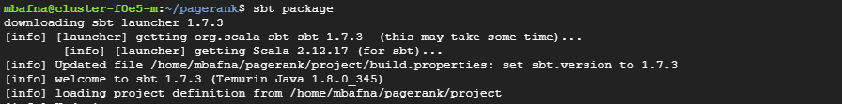
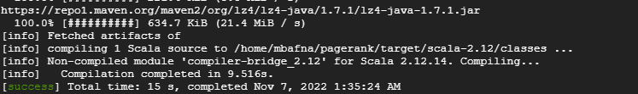
Implementation on GCP using SCALA
Now create the jar file
Command: sbt package

Slide 35
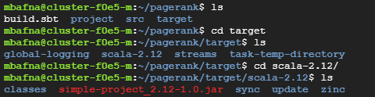
Implementation on GCP using SCALA
Validate the jar file location

Slide 36

Implementation on GCP using SCALA
Create a new bucket on GCP

Slide 37
Implementation on GCP using SCALA
Now push the input file and the jar files to the newly created bucket using gsutil commands:

Slide 38
Implementation on GCP using SCALA
Run the gcloud command:
gcloud dataproc jobs submit spark --cluster=cluster-f0e5 --region=us-west1 --jars=gs://pagerank_mb/simple-project_2.12-1.0.jar --class=org.apache.spark.examples.SparkPageRank -- gs://pagerank_mb/pagerank.txt 10

Slide 39
Implementation on GCP using SCALA
Run the gcloud command:

Slide 40
Test
Result for 10th Iteration:

Slide 41
Conclusion
Implement PageRank using GCP Spark
Used both Python and Scala to implement a pagerank algorithm
Observation
Input Web Pages' impact to the PageRank of a web page
The more Input Web Pages the better.
The higher PageRank of an Input Web Page the better.
A web page does not have input will have
Smallest PageRank
Constant PageRank

Slide 42
Enhancement Ideas
Test more complicated cases
Compare python run to scala run, e.g. runtime, complexity
Consider different popularity factors

Slide 43
References
PageRank Example (sfbu.edu)
HW2 PageRank (ucsb.edu)

